Slide 1
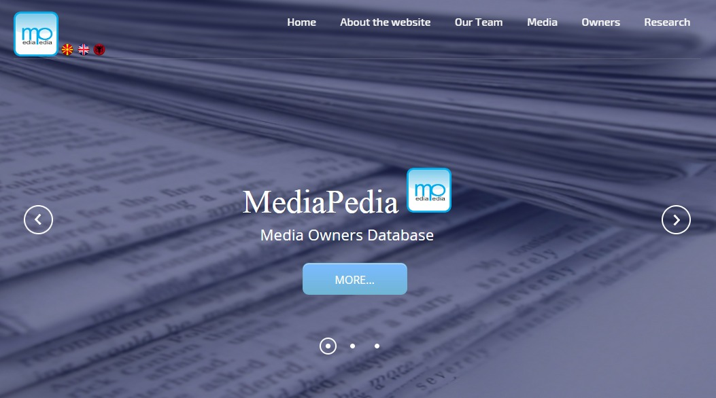

Slide 2
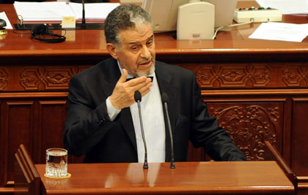
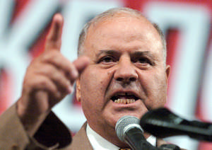
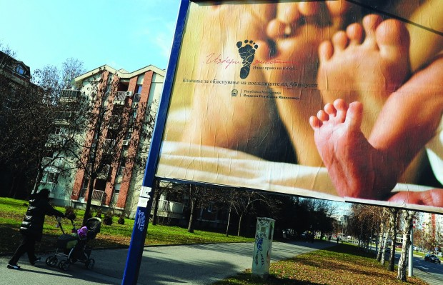
Two pillars of media corruption
- media ownership
- media campaigns paid by the Government

Slide 3

Elections
Biggest media donate for the ruling party campaign
Elections are won
Biggest media get money for Government
campaigns fund by budget money

Slide 4
2014 Elections donations
МПМ 251.061 euros
ТВ Сител 160.227 euros
Канал 5 144.480 euros
ТВ Алфа 76.000 euros
First half of 2014
The Government spends 4 million euros on campaigns for
“public benefit”

Slide 5
How much money the Government is spending?
By witch criteria the Government selects the media for the public campaigns?
List of the media and the money that they get?
SORRY!
1.You need security certificate!
2. It’s a personal data!

Slide 6

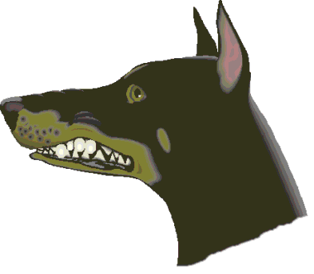

Slide 7
Why Mediapedia?
44 % of Macedonians are getting informed from the web everyday or almost everyday
(2013)

Slide 8
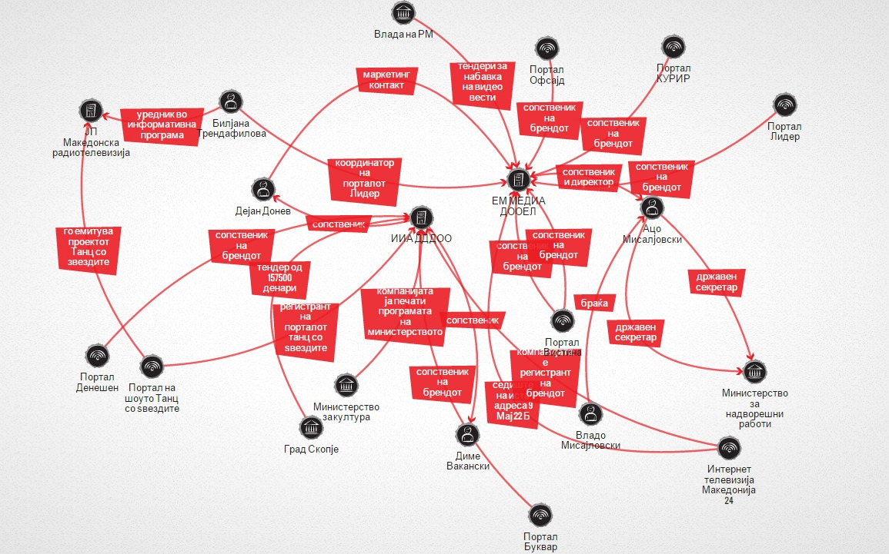
www.kurir.mk

Slide 9
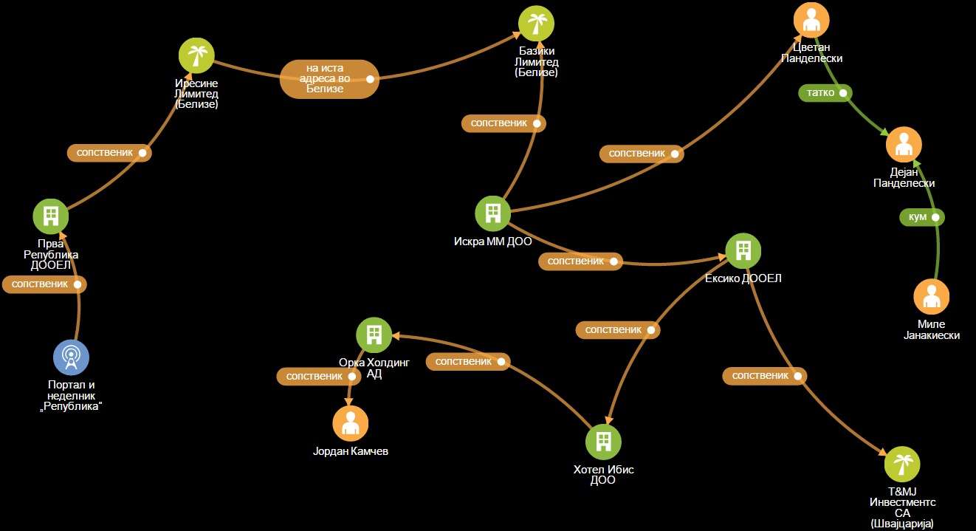
www.republika.mk

Slide 10
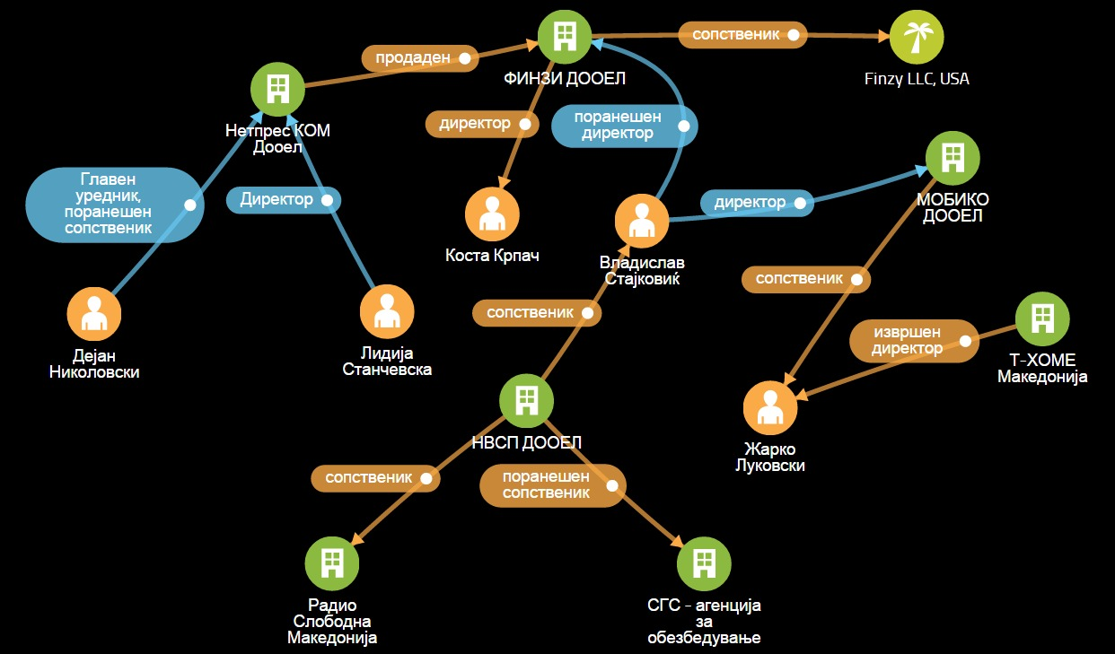
www.netpress.mk

Slide 11
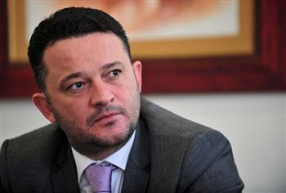
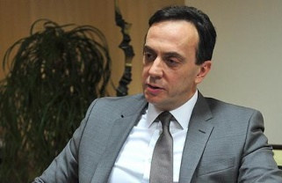
Orce Kamcev
Saso Mijalkov

