Slide 1
Regional conference on anti-corruption in the media systems in the countries of South East Europe
»Media integrity matters«
Jasminka Dzumhur, Ombudsperson of BiH
“Role of national human rights institutions”
Ljubljana, 1. December 2014

Slide 2
State obligations related to global and regional standards of human rights
  Consolidation of legal framework by means of reform of domestic legislation and adherence to international human rights standards;
  Increase the awareness on international human rights standards
  Ensure application implementation of international human rights standards
  Support to initiatives which main aim is to enhance and promote human rights, such as ombudsman institutions, independent judiciary, free media, democratic elections etc.
  Mainstream human rights into other program areas

Slide 3
Frame for acting of NHRI
  Paris principles identify NHRIs´ human rights objectives and provide for their independence, broad human rights mandate, adequate funding, and an inclusive and transparent selection and appointment process.
  NHRIs responsibilities:
  submit to the Government, Parliament and any other competent body opinions, recommendations, proposals and reports on any matters concerning the promotion and protection of human rights;
  promote and ensure the harmonization of national legislation regulations and practices with the international human rights instruments to which the State is a party, and their effective implementation;
  encourage ratification of the international instruments or accession to those instruments, and to ensure their implementation;

Slide 4
Frame for acting of NHRI
  contribute to the reports which States are required to submit to UN bodies and committees, and to regional institutions, pursuant to their treaty obligations and, where necessary, to express an opinion on the subject, with due respect for their independence;
  cooperate with the UN and any other organization in the UN system, the regional institutions and the national institutions of other countries that are competent in the areas of the promotion and protection of human rights;
  assist in the formulation of programmes for the teaching of, and research into, human rights and to take part in their execution in schools, universities and professional circles;
  publicize human rights and efforts to combat all forms of discrimination, in particular racial discrimination, by increasing public awareness, especially through information and education and by making use of all press organs

Slide 5
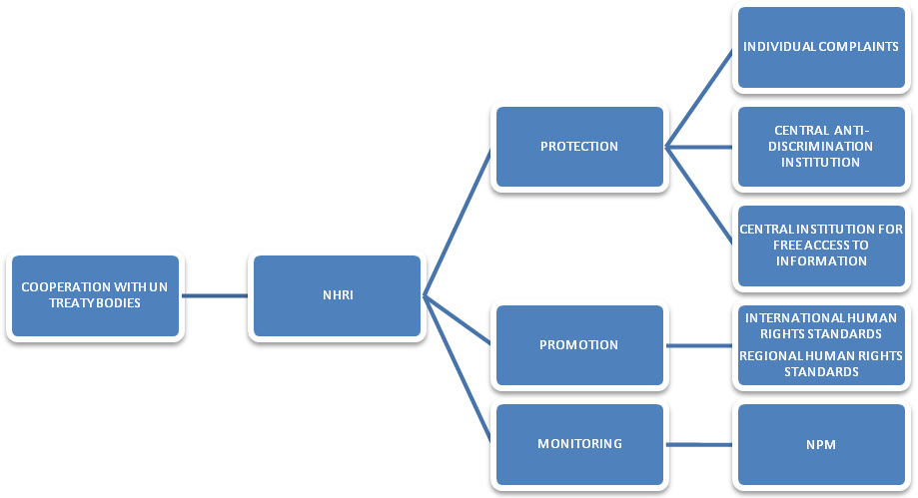
Ombudsmen Institution

Slide 6
Ombudsmen Institution (OI)
Established in according to the Annex IV and VI of DPA with aim to protect human rights and promote good governance and the rule of law.
BiH Ombudsman is functioning on the basis of BiH Constitution and the Law on the Ombudsman which guaranties its independence and provides infrastructural framework for the protection and promotion of human rights and fundamental citizens’ freedoms.
Additional mandates:
  Law on prohibition of discrimination;4
  Law on free access to information;
  Law on governmental and ministerial appointments

Slide 7
Mandate of NHRI
  Law on ombudsmen BiH
  promote good governance and the rule of law
  protect the rights and liberties of natural and legal persons
  monitor activities of the institutions of BiH, entities, and Brcko District
  consider cases of violations of human rights and liberties committed by any government body
  complains or ex-officio
  power to investigate all complaints made about poor functioning of the judicial system or administration

Slide 8
Mandate of NHRI
Anti-Discrimiantion Law - Central Institution for Protection of Discrimination
  Receive individual and group complaints related to discrimination;
  Provide needed information to natural and legal persons who filed a complaint for discrimination about their rights and obligations,
  Propose initiation of process of mediation
  Collect and analyze statistical data on discrimination cases;
  Deliver annual and if necessary extraordinary reports on discrimination to the Parliamentary Assembly of BiH, FBiH Parliament, RS National Assembly and Brcko District Assembly;
  Inform the public on discrimination manifestations;
  Conduct surveys in the field of discrimination on its own initiative;
  Give opinions and recommendations
  Monitor the legislations and provide advices to legislative and executive bodies;
  Improve policy and practices aiming to ensure equal treatment.

Slide 9
Mandate of NHRI
Prohibition of discrimination shall be applied to all public bodies, all natural and legal persons, in public and private sector, in all spheres, especially: employment, membership in professional organizations, education, training, housing, health, social protection, goods and services designated for public and public places together with performing economic activities and public services.
When developing regular reports, opinions and recommendations on discrimination manifestations, the BiH Ombudsman shall cooperate with civil society organizations dealing with protection and promotion of human rights and organizations dealing with protection of groups at high risk of discrimination.

Slide 10
Mandate of NHRI
Free access to information
Ombudsman may inter alia consider:
  creating and disseminating information such as guidelines and general recommendations concerning the administration and implementation of LFAI;
  including in its annual report a special section regarding its activities in relation to LFAI
  proposing instructions on the implementation of LFAI to all competent ministries within BiH
  complaints

Slide 11
What are indicators
International obligation of BiH related to human rights
National mechanism system of protection of human rights
LEGISLATION
INSTITUTIONS
PROCEDURES

Slide 12

The main human rights violations from area of political and civil rights from the perspective of BiH OI
Violations | Received in 2012. Total 1.717 | Received in 2013. Total 1.734
Courts | 637 | 565
Administration | 381 | 451
Property | 150 | 142
Access to information | 225 | 208
Governmental and ministerial appointments | 115 | 131
Police | 123 | 126
Public documents | 26 | 29
Prosecution | 44 | 62
War damages | 11 | 9
Public Attorney | 5 | 6
Media and freedom of information | 2 | 5
20

Slide 13
NHRI, media and corruption
Media as a violator of human rights
Media and journalists as victims
Media as partners in fighting against corruption
Different role of Ombudsmen depending of media ownership
Protection of whistleblowers
Role of regulatory agencies
Issue of integrity

