Slide 1
The Eronet Case 2013/2014
Esad Hećimović (Sarajevo)
Blaž Zgaga (Ljubljana)
Herwig Höller (Graz)

Slide 2
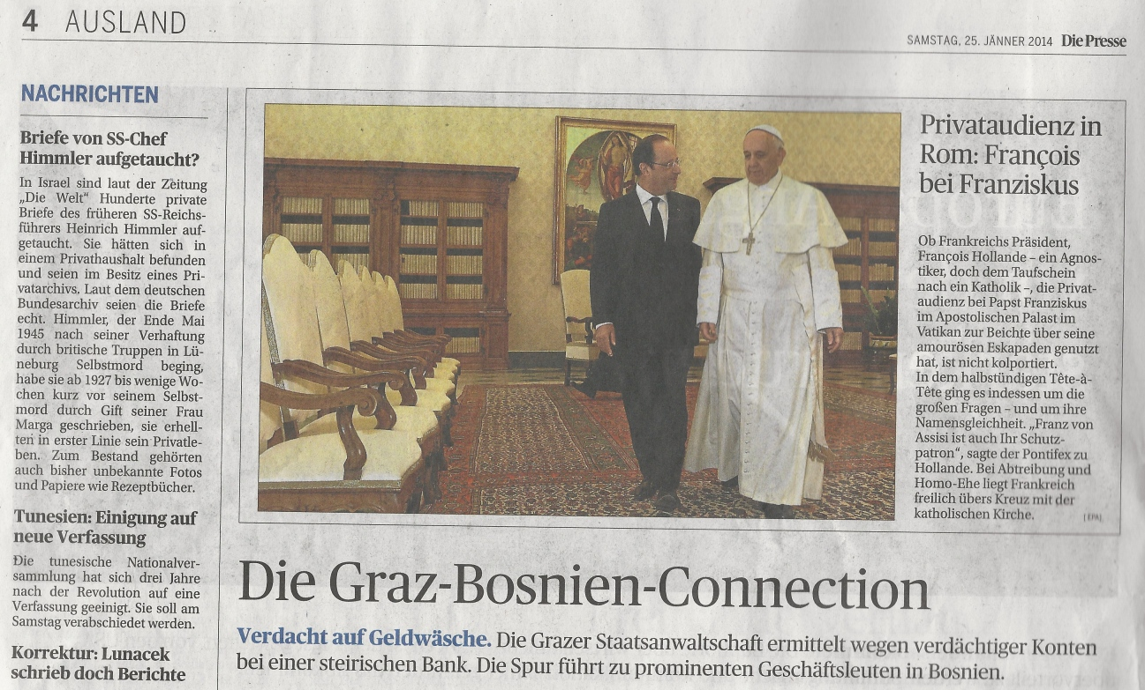
Die Graz-Bosnien Connection
Die Presse (Graz)
25. 01. 2014.

Slide 3
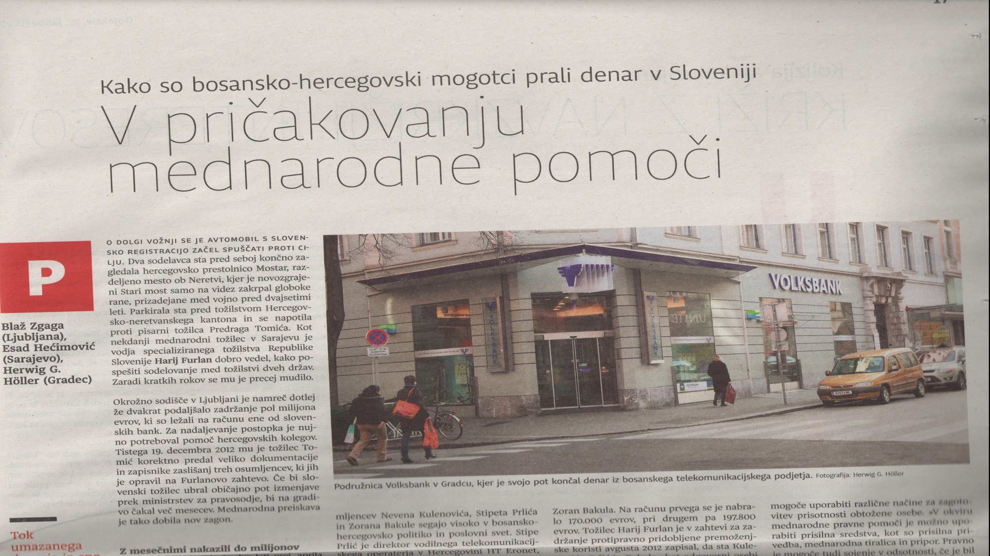
V pričakovanju mednarodne pomoči
Dnevnik (Ljubljana)
25. 01. 2014.

Slide 4
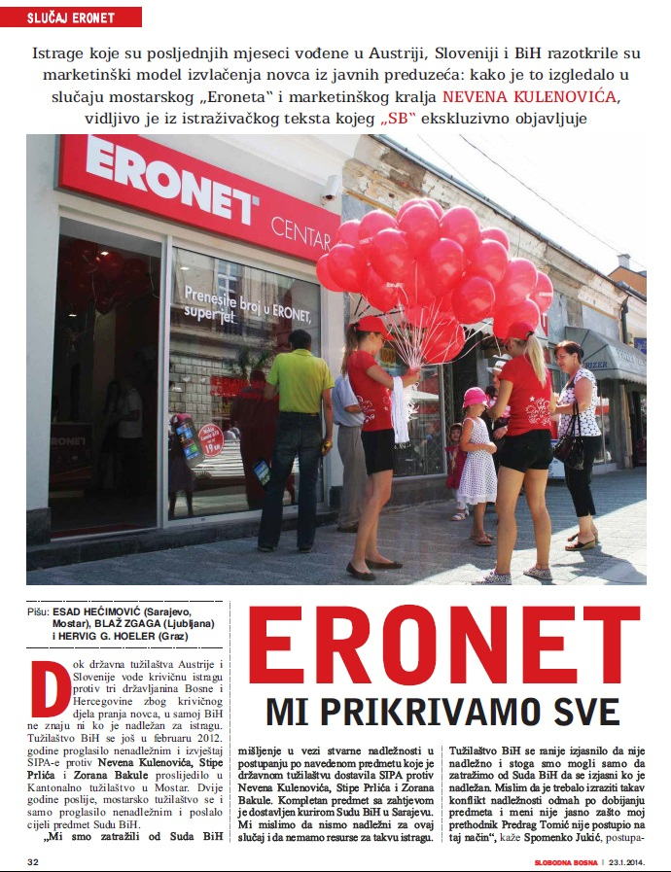
Eronet MI PRIKRIVAMO SVE
Slobodna Bosna (Sarajevo) 23. 01. 2014.

Slide 5
Objectives
Sharing aim to transform leaked information to quality journalism
Crossborder research in three countries from Mostar and Sarajevo in BiH, through Ljubljana in Slovenia to Graz in Austria
Exchange of information and sources;
Using power of local knowledge and local networking to build regional impact

Slide 6
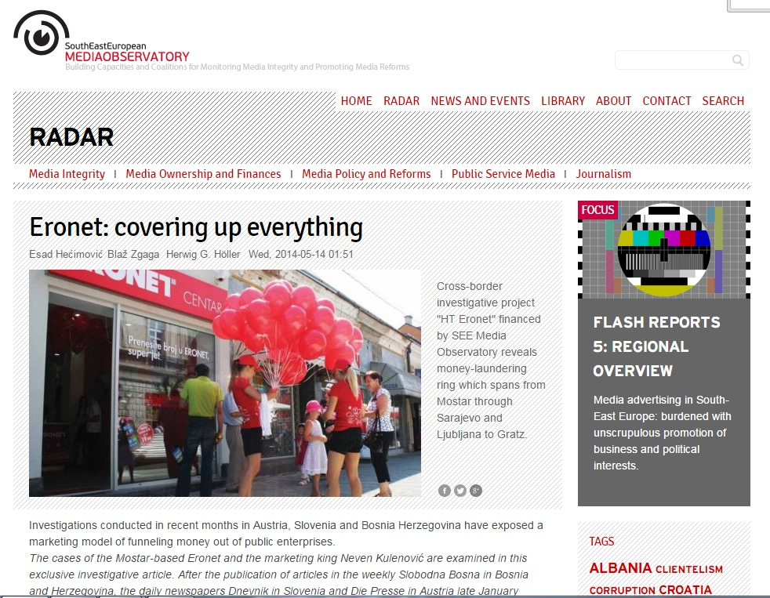
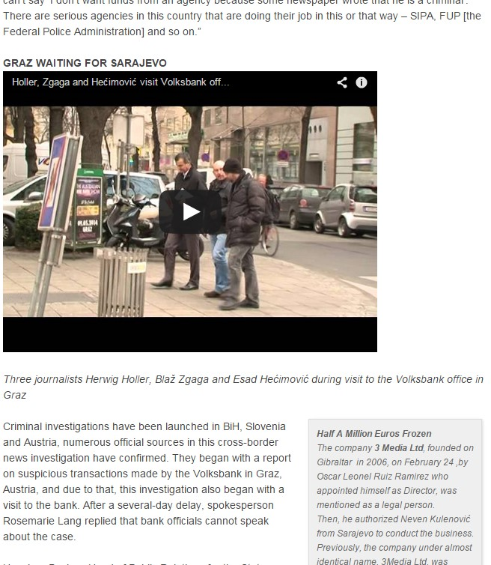
Eronet: covering up everything
http://mediaobservatory.net/radar/eronet-covering-everything
14. 05. 2014.
FULL STORY

Slide 7
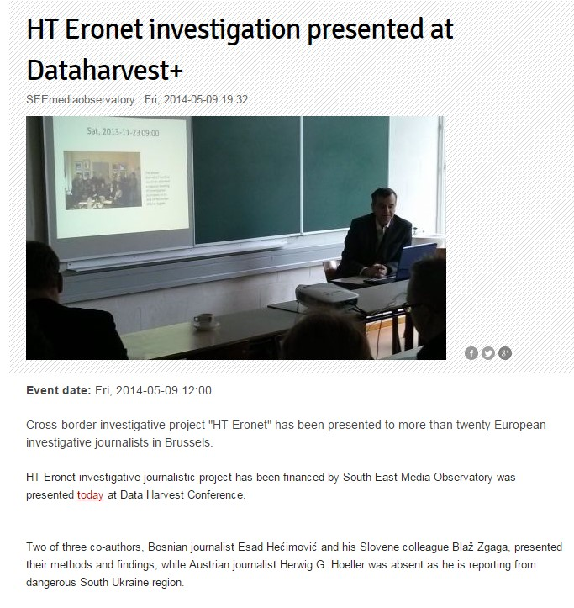
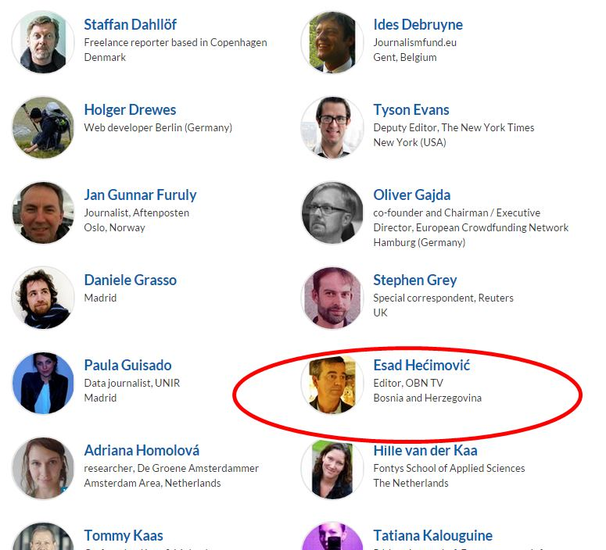
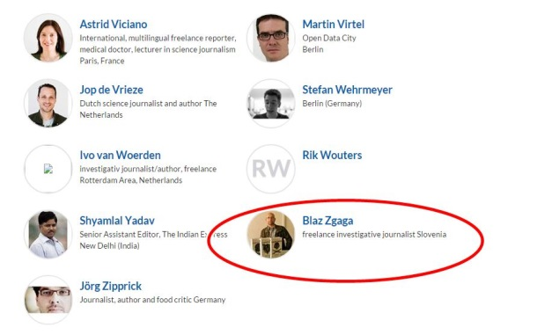
Dataharvest + 2014
Brussels , May 8-11 2014
THE EUROPEAN INVESTIGATIVE AND DATA JOURNALISM CONFERENCE

Slide 8
Eronet case
Money
HT ERONET
SVRSA
3 Media Ltd
PRLIĆ
BAKULA
Public companies
United Media
FTV
Agencies owned by Neven and Belma Kulenovic

Slide 9
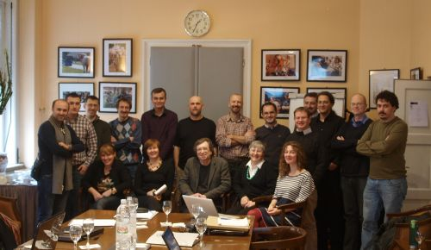
Regional discussion
Zagreb, 23-24 . 11. 2013.
Regional model for misuse of marketing funds discussed

Slide 10
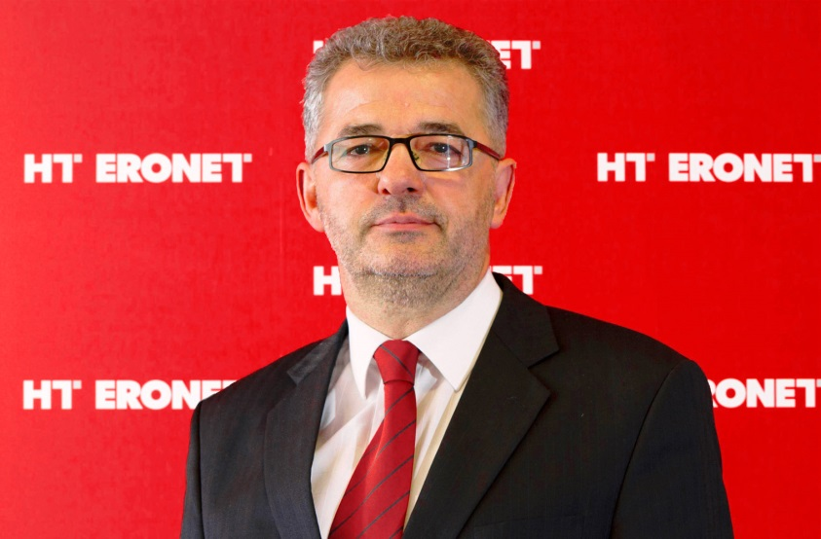
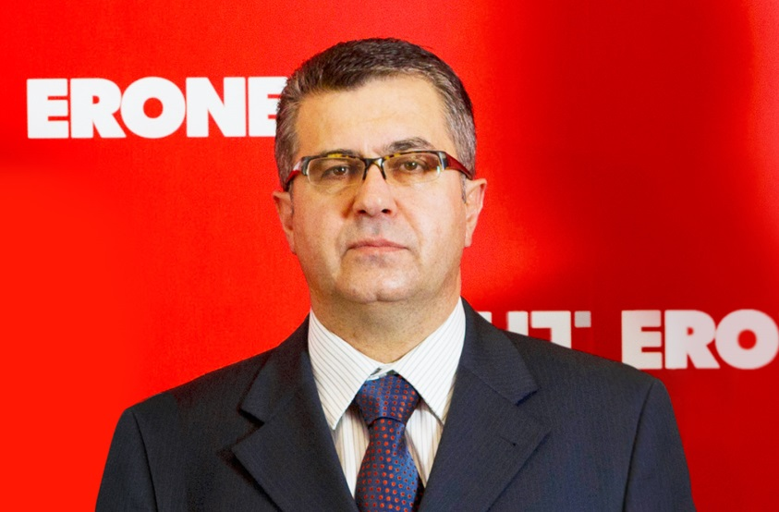

Eronet case
2011
Austrian police noticed large amount of money on two accounts (arround 200.000 euro on each account) belonging to two citizen of BiH. Both of them are directors of Public company Croatian telecommunications Eronet dd Mostar

Slide 11
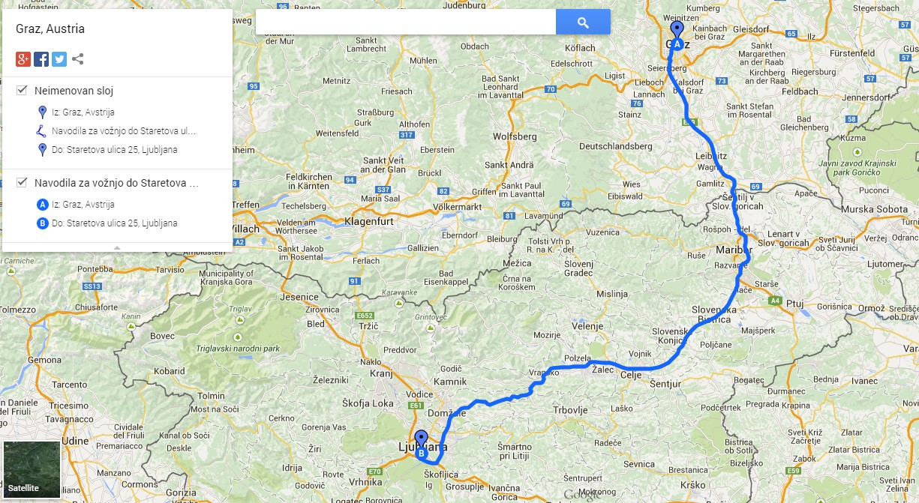
Graz – Ljubljana
Austria asked Slovenian police to check what's goign on.
Investigation was started by Hari Furlan, chief investigator of Special prosecutor office for organized crime in Slovenia.

Slide 12
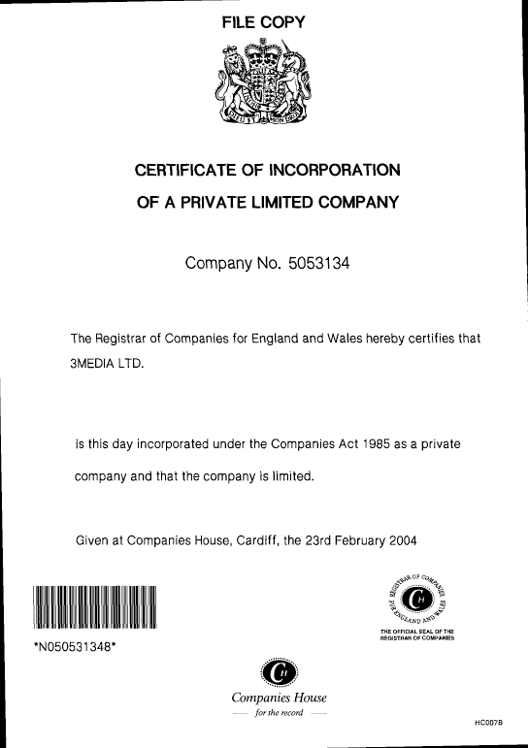
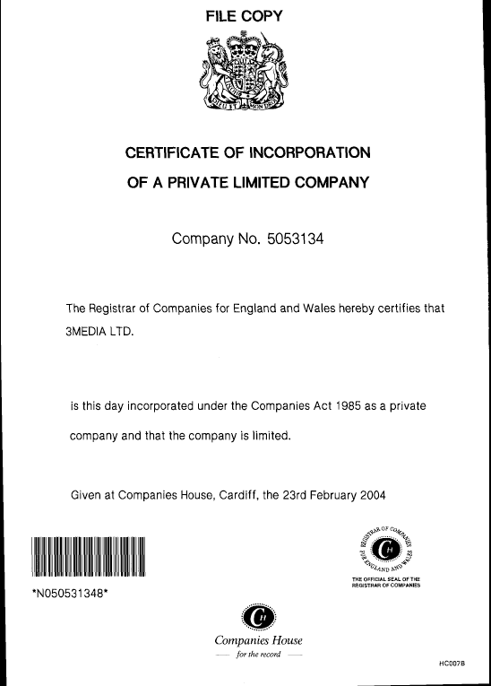
Offshore 3Media Ltd
Money was payed from account owned by 3Media LTD , offshore company from Gibraltar owned by one citizen of Mexico (Oscar Leonol Luiz Ramirez ).

Slide 13
Media buying Balkan way
Several marketing agencies and TV stations paid to bank account owned by 3Media Ltd in Ljubljana 4,2 milion Euro for fictional TV rights
From that fund director of 3 Media Ltd paid money to several private accounts in diferent states, including accounts of Eronet’s director

Slide 14
Media buying Balkan way
Director of 3Media Ltd is Neven Kulenovic.
He and his wife are also owners or directors several marketing agencies including S.V.-R.S.A and Media United.
SVRSA was winner of several teneders of Eronet for marketing and advertising .
Media United agency got up to 85 percent of disccount at public Federal TV station
He has tried to move this money from Ljubljana bank account, but it was prevented by anti-moneylaundering authorities in Slovenia. Money is stil under blockade in Ljubljana

Slide 15
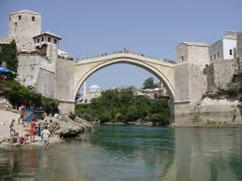
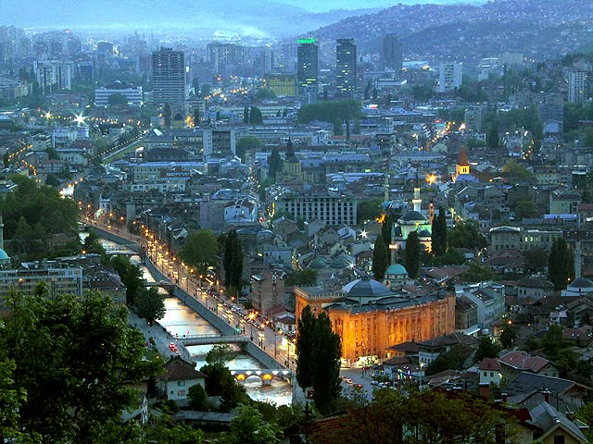
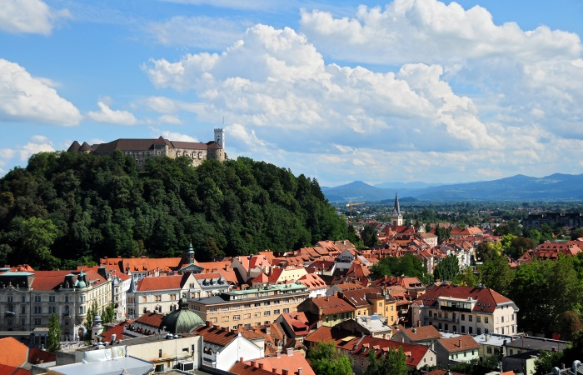
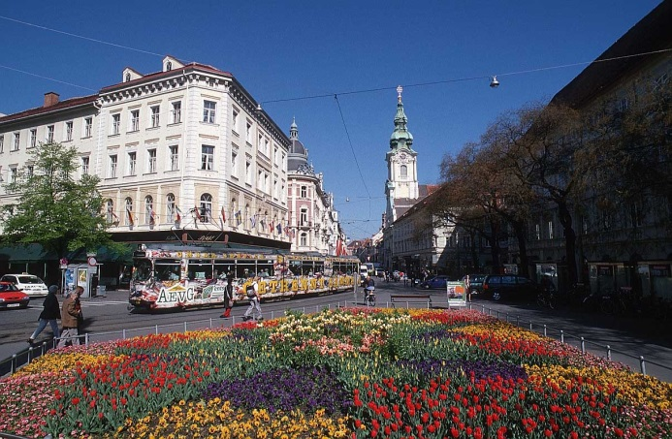
INVESTIGATION IN THREE COUNTRIES AND FOUR CITIES

Slide 16
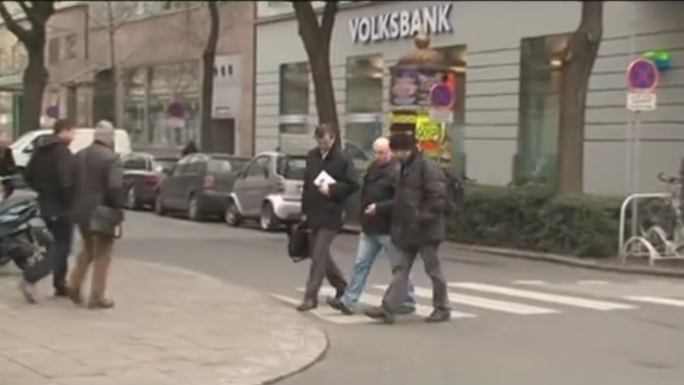
Team of journalists working at the scene in Graz

Slide 17
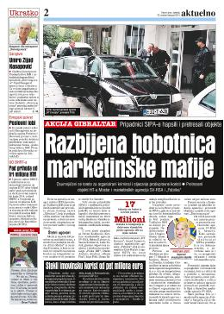
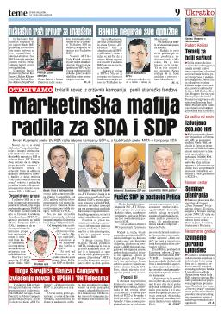
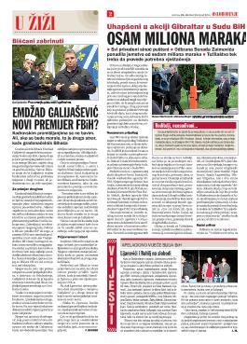
9 suspects arrested
Operation Gibraltar
22. 10. 2014.

Slide 18
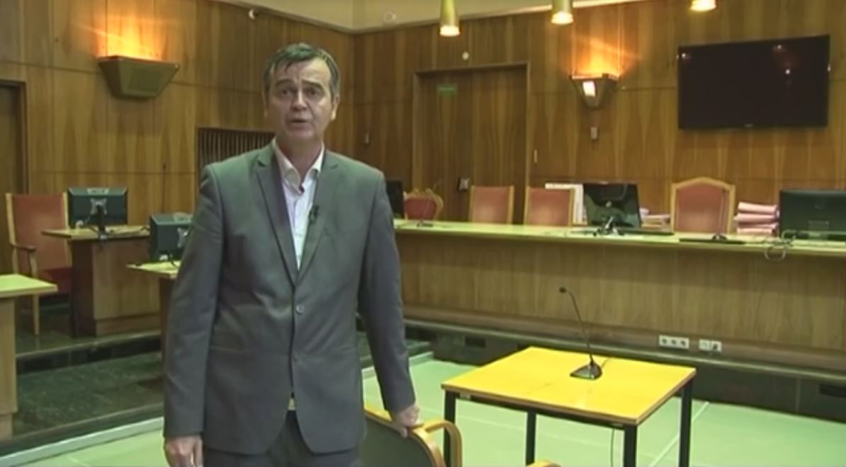
In the Courtroom...

