Slide 1

Ethical Journalism Network
Media Integrity In a
New World
Of Information
Aidan White
Twitter: aidanpwhite
aidanpatrickwhite@gmail.com

Slide 2
Who we are
A coalition of media professional groups from around the world aiming to strengthen the craft of journalism.
We are committed to building trust in media and promoting principles of ethical journalism, good governance and self-regulation in the digital age
www.ethicaljournalismnetwork.org

Slide 3
African Centre for Media Excellence
African Media Initiative
Alliance of Independent Press Councils of Europe
Article 19
Asia-Pacific Broadcasting Union
Association of Commercial Television in Europe
CASCFEN
Center for International Media Ethics
Center For Media Freedom & Responsibility
Editor-In-Chiefs Forum Hungary
European Broadcasting Union
European Federation of Journalists
European Journalism Centre
European Magazine Media Association
European Newspaper Publishers Association
European Publishers Council
Fundación Nuevo Periodismo Iberoamericano
Global Editors Network
Global Forum for Media Development
iMediaEthics
International Association of Women in Radio & Television
International Press Institute
Internews Europe
Media Diversity Institute
MediaWise
Online News Association
Organization of News Ombudsmen
Pakistan Coalition for Ethical Journalism
PANOS South Asia
Punto24
Religion News Service
Reynolds Journalism Institute
South East Europe Media Organisation
South East Europe Network for Media Professionalization
Tanzania Journalists Alliance
Thomson Foundation
World Association of Newspapers and News Publishers
World Press Freedom Committee

Slide 4
Ethical Journalism is
Not Free Expression
Journalism is not free speech, it is constrained expression
It works in a framework of values.
It has purpose.
It is a public good.
It shapes the norms and values of society.

Slide 5
Media Integrity:
Roots of the Crisis
Political and cultural affiliations of media
Market instability: sustainability crisis
Media not ordinary business ventures
Bias, self-interest
Reluctance to change
Democracy (state) still under construction
Weak and strong intermediary organisations
Regulation and Law: inadequate or not enforced
Patronage and Corruption in public life

Slide 6
Decline of Press Freedom in Democratic Countries
Ratings are down
Intrusive media policy of state over: terrorism, privacy, social media
Progress in Law, but limited in practice
Media ownership not for profit, but for political or other self-interest
Declining Status of Journalists

Slide 7
Result: Weak Media Attachment to Values
Poor ethical standards at all levels
Conflicts of Interest and Lack of Transparency
Corruption and inadequate internal governance
Absence of Credible Self-regulation
Breakdown of Editorial/Commercial Divide

Slide 8
Digital, Open Journalism
Audience is new layer of Media Pyramid
Confusion over who is a journalist and what are acts of journalism
Rethinking role and work of journalism: more analysis, context, explanation and meaning
Challenge of Rush to Publish and Clicks over Content
Responsibility of all in use of information

Slide 9

Do-it-yourself ethics
code project

Slide 10
Fundamental principles
Truth telling
Avoiding Conflicts of Interest
Accountability: corrections and engagement with the audience
Objective or point of view Journalism?
Ethical awareness at all levels of Media Pyramid

Slide 11
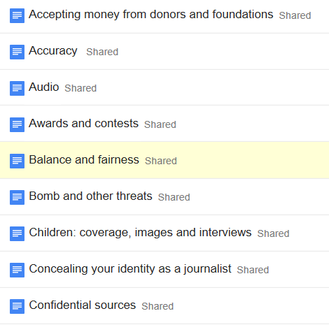
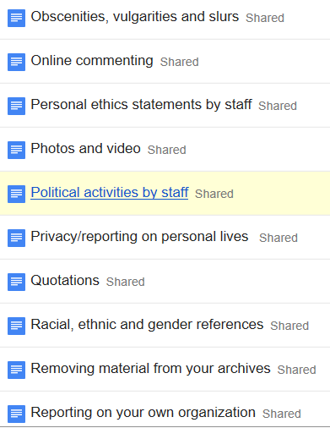
40 specific areas

Slide 12
Have Your Say
bit.ly/onacrowdsourcing
Tom Kent
onaethics@gmail.com

Slide 13
Integrity as a Driver of Public Information
Integrity in public information:
Government/political information
Corporate Information
Journalism (public interest)
Public Voices

